Slide 1
Comparing two gym’s websites
By Felix

Slide 2
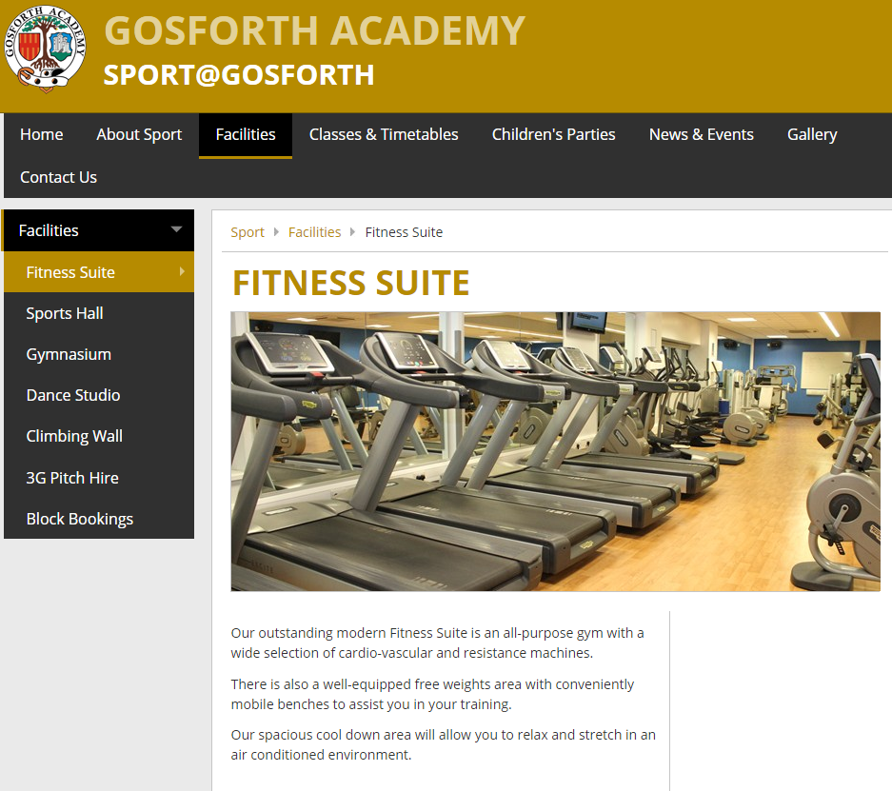
Sport @ Gosforth
They include a small paragraph about each place that they have to offer which helps for you to decide where to go.
There is all of the information you need about opening times and classes with prices and times that they are on.
They also use it as a way of advertising that they can take children’s parties and show some pictures of all the facilities they have

Slide 3
Advantages
They give all the information that you need to be able to find a class and go
It tells all of the facilities they have on offer

